Slide 1
NURA Data
2/23/24

Slide 2
Purpose CAN DO THIS LATER

Slide 3
Demographics (N = X) CAN DO THIS LATER
Age M(SD):
Gender:
mTBI n:
Control n:
Notes:
CAN DO THIS LATER

Slide 4


Task Diagram (BLOCKED and INTERMIXED blocks)
Recognition Trial
SOA: 400-500 ms
100 ms
900 ms
Response (3000 ms)
SOA: 400-500 ms
100 ms
900 ms
Response
Recall
Trial
Notes:
Blocks of 25; mix recognition and recall trial blocks (smaller)
Plot as function of K?? Not sure why???

Slide 5
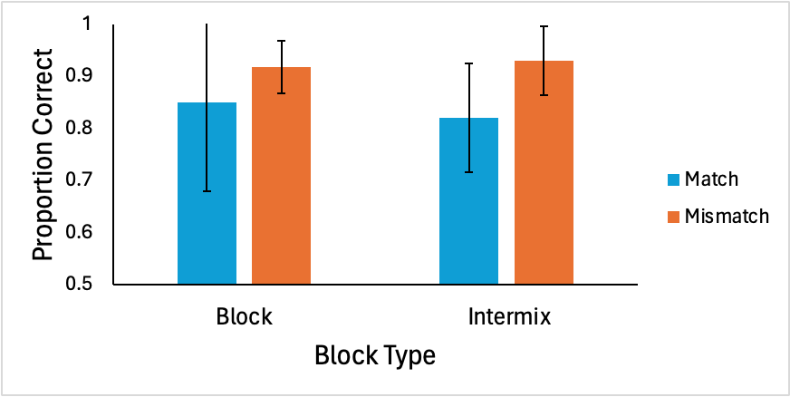
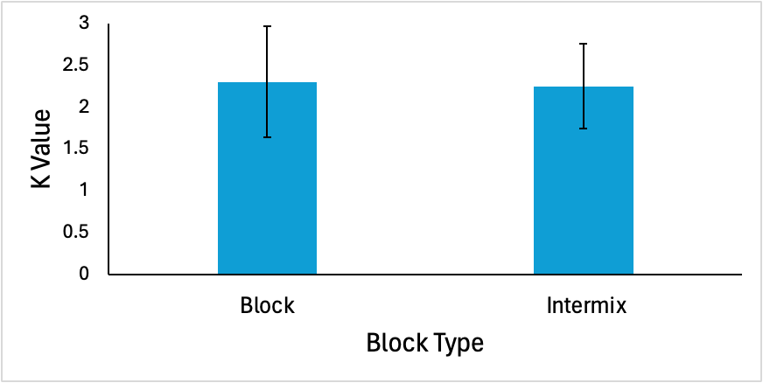
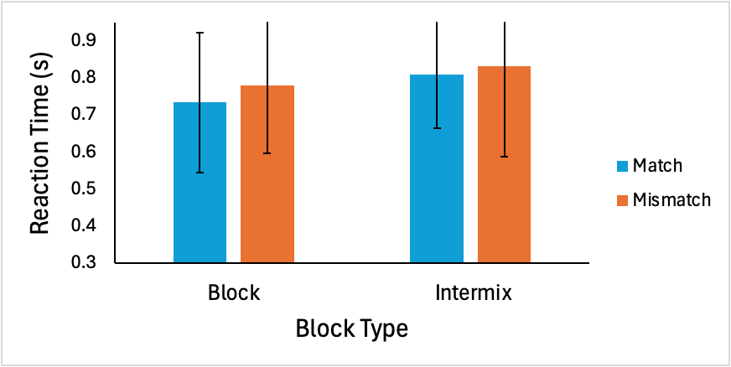
Recognition Data (N = X)
Error bars represent 95% CI

Slide 6
Recognition Data x Group (mTBI n = X, Control n = X)
Error bars represent 95% CI
Notes:
Proportion Correct: collapse match and mismatch; should have 4 bars total (2 mTBI and 2 Control); do NOT make them the same color as match and mismatch graphs
K-Value: 4 bars total; make them the SAME color as proportion correct x group graph
RT: collapse match and mismatch; should have 4 bars total (2 mTBI and 2 Control); do NOT make them the same color as match and mismatch graphs

Slide 7
Recog across trials – can do later

Slide 8
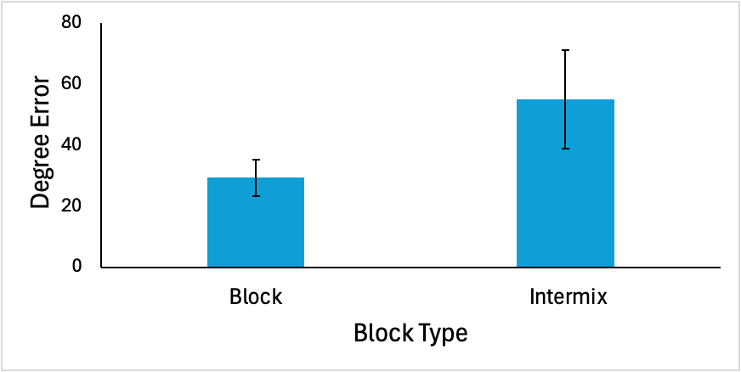
Recall Data (N = 3)
Error bars represent 95% CI
Notes:
Performance as a section of block

Slide 9
Recall Data x Group (mTBI n = X, Control n =X)
Error bars represent 95% CI
Notes:
4 bars - same colors as recog x group graphs

Slide 10
Recall across trials – can do later

Slide 11
BIS-Brief CAN DO THIS LATER
M(SD)
Score x group (mTBI v Control)
Score x performance
Graph 1: recog acc (4 lines – mTBIxBlock, mTBIxIntermix, controlxBlock, controlxIntermix)
Graph 2: recog RT (4 lines – mTBIxBlock, mTBIxIntermix, controlxBlock, controlxIntermix)
Graph 3: recog K value (4 lines – mTBIxBlock, mTBIxIntermix, controlxBlock, controlxIntermix)
Graph 4: recall err (4 lines – mTBIxBlock, mTBIxIntermix, controlxBlock, controlxIntermix)
BIS-Brief: Barratt Impulsiveness Scale - Brief
Notes:
CAN DO THIS LATER

